Slide 1
Jolt: Draw a Tree
Please take 2 minutes to draw a tree.
Please use an 8”x11” sheet of card stock and the markers for this project.
The drawing can be realistic or abstract.
You must finish in 2 minutes.

Slide 2
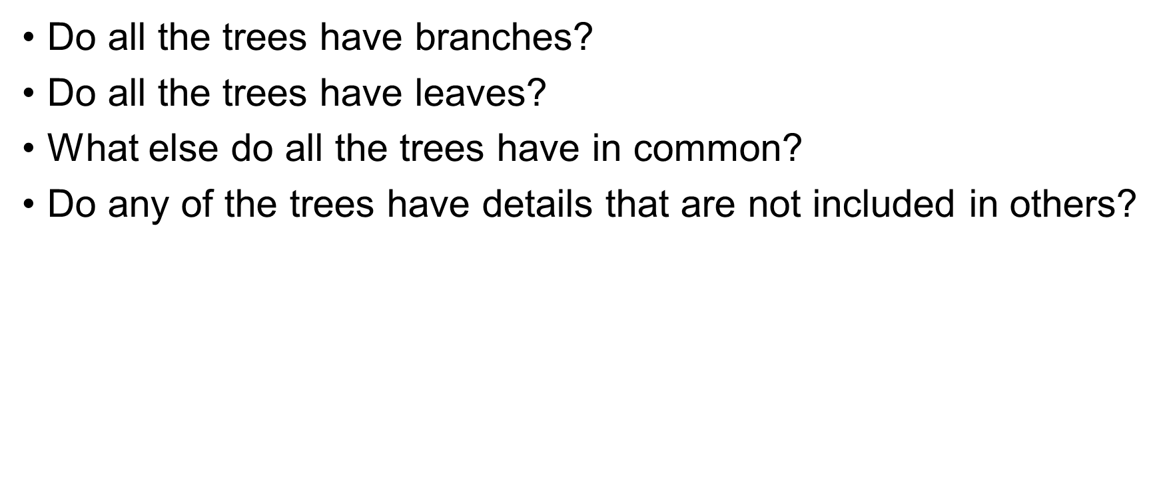
Take a moment to admire the trees of others at the table.

Slide 3
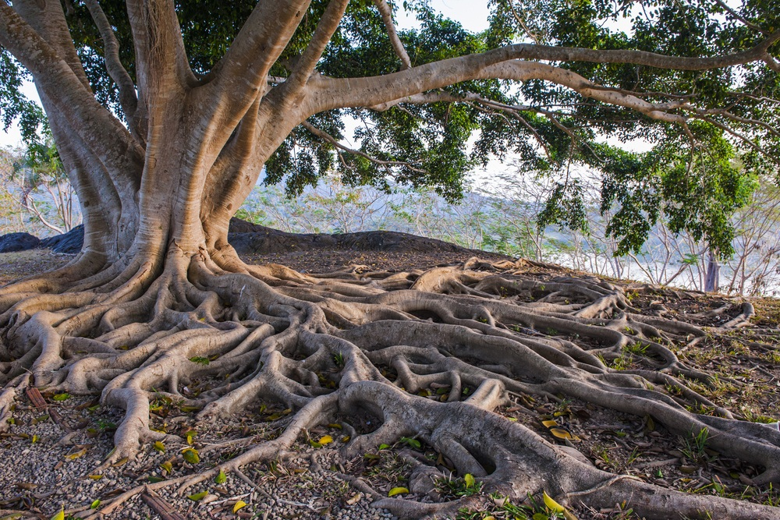
We tend to ignore things that are not clearly visible.
Very often the things we choose to ignore play an important role in our success.

